Slide 1
Main Challenges of Machine Learning
Machine learning models fail mainly because of data and model issues.
Insufficient Quantity of Training Data
Nonrepresentative Training Data
Poor-Quality Data
Irrelevant Features
Overfitting the Training Data
Underfitting the Training Data

Slide 2
Insufficient Quantity of Training Data
Insufficient training data means the model does not see enough varied examples to learn the true patterns, so it performs well on the few training points but fails on new, unseen data.
This is one of the core practical challenges in machine learning and is tightly linked with overfitting and poor generalization.
This leads to high variance: the model changes a lot if you slightly change the dataset.
Example: You build a skin-cancer classifier from only 500 images collected from one small hospital. The model reaches 99 percent accuracy on this small training set but drops to 60 percent on images from another hospital or different skin tones. The model has not seen enough diversity in lesions, lighting, and skin types to generalize.

Slide 3
Nonrepresentative Training Data
Even with many samples, if they do not reflect the true population or use-case, the model learns a biased view of the world. This happens due to sampling bias (who you include) or selection bias (how you choose data).
Example: A credit scoring model is trained mostly on data from salaried urban customers because those are easier to obtain. When deployed to semi-urban or self-employed applicants, it systematically underestimates their creditworthiness, since their patterns were rarely present in the training set.

Slide 4
Poor-Quality Data
Poor-quality data includes incorrect values, missing fields, inconsistent formats, duplicated records, and wrongly labeled targets. Models trained on such data learn wrong relationships.
Example: In a hospital dataset, blood pressure is sometimes recorded in the wrong column or with swapped systolic/diastolic values, and some diagnoses are mislabeled due to manual entry errors.
The model then learns that dangerously high blood pressure can be associated with “healthy” labels and gives misleading risk scores.

Slide 5
Irrelevant Features
Irrelevant or weakly related features add noise, make the model more complex, and hurt both interpretability and generalization. This is particularly harmful for models sensitive to dimensionality (e.g., distance-based methods).
Example: Predicting house prices using features such as listing ID, seller name, and image file size along with useful features like area and location. The irrelevant features can dominate distance calculations in k‑NN or encourage a tree to split on useless attributes, increasing overfitting and reducing accuracy on new listings.

Slide 6
Overfitting the Training Data
Overfitting occurs when the model is too flexible and captures noise or random fluctuations as if they were true structure.
It achieves very low training error but much worse error on validation or test sets.
Example: A training model for product demand forecasting is trained on one year of sales data and memorizes all holiday spikes and random promotions.
On the training period it predicts nearly perfectly; on the next year it fails when promotions change or holidays fall on different weekdays, because it learned specific dates rather than general seasonal patterns.

Slide 7
Underfitting the Training Data
Underfitting happens when the model is too simple to capture the real relationships in the data.
Both training and test errors are high, indicating high bias.
Example: Using a basic linear regression to model a clearly nonlinear relationship between engine size and fuel consumption. Even on the training data the line cannot follow the curve; adding more data does not fix the problem because the model family itself is inadequate.

Slide 8
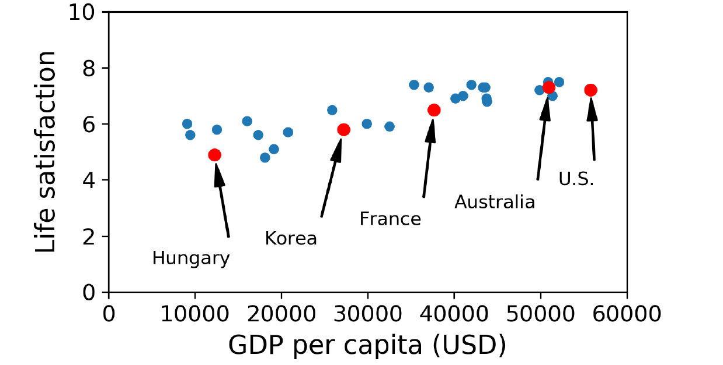

Slide 9
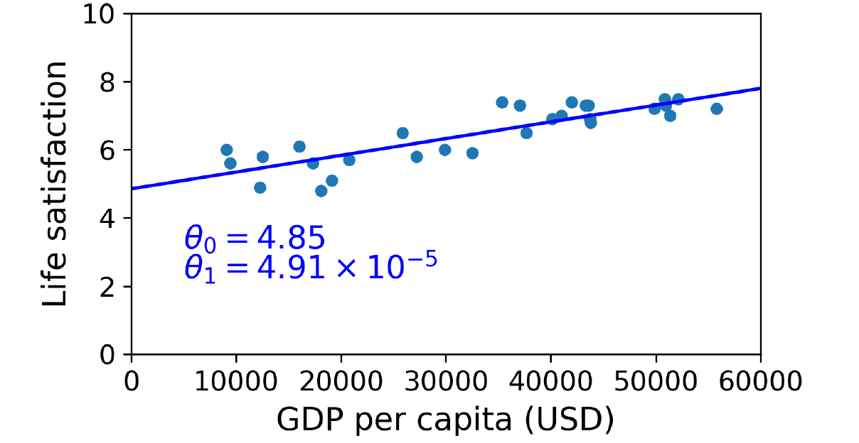


Slide 10
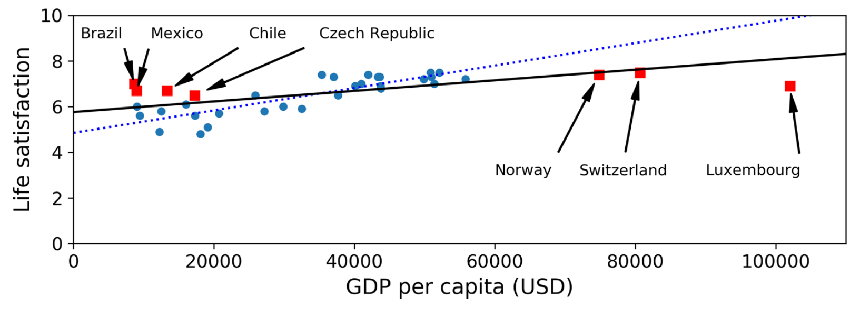

Slide 11
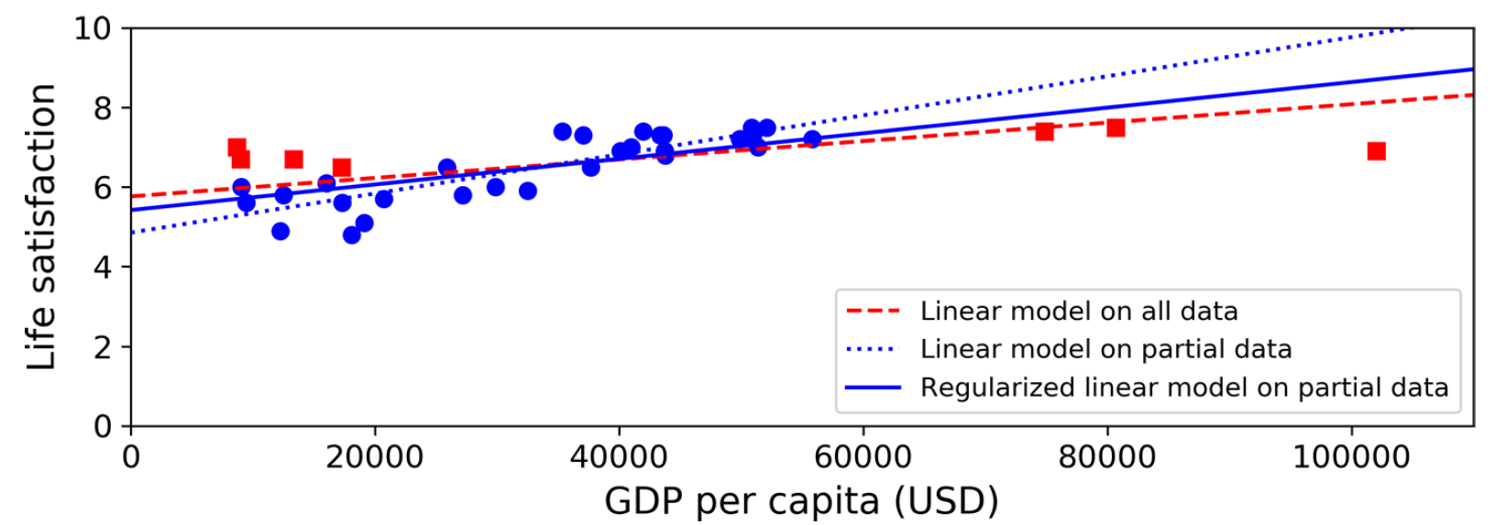

Slide 12
Two types of model errors
There are two types of model errors when making an estimate
Bias and Variance
Understanding both of these types of errors, as well as how they relate to one another is fundamentally important to understanding model overfitting, underfitting, and complexity.

Slide 13
Bias
Bias is the difference between a model’s estimated values and the “true” values for a variable.
Bias can be thought of as errors caused by incorrect assumptions in the learning algorithm.
Bias can also be introduced through the training data, if the training data is not representative of the population it was drawn from.
In the fields of science and engineering, bias is referred to as accuracy.
Bias can cause an algorithm to incorrectly identify or miss important relationships, which in turn can cause underfitting. Underfitting describes when a model is unable to capture the "true" underlying pattern of the data set (i.e., the model fits the data poorly).

Slide 14
Variance
Variance can be described as the error caused by sensitivity to small variances in the training data set, or how much an estimate for a given data point will change if a different training data set is used.
High variance can cause an algorithm to base estimates on the random noise found in a training data set, as opposed to the true relationship between variables.
In the fields of science and engineering, bias referred to as precision.
High variance is associated with overfitting a model, where a model will perform well on its given training data set but generalize to unseen observations poorly. Overfitting happens when the models capture and describe random noise in the training data set, as well as the underlying pattern in the data.

Slide 15
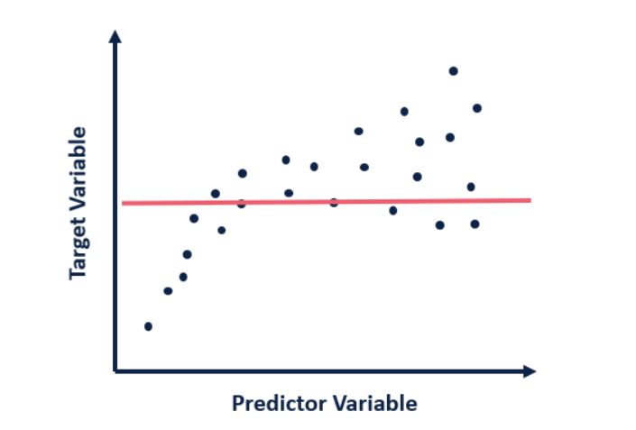
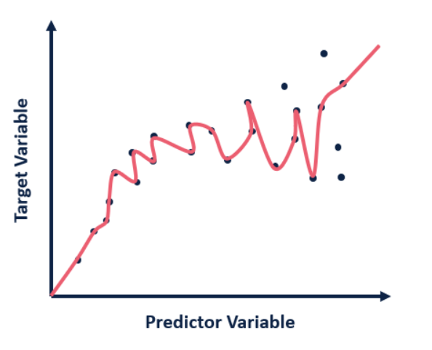
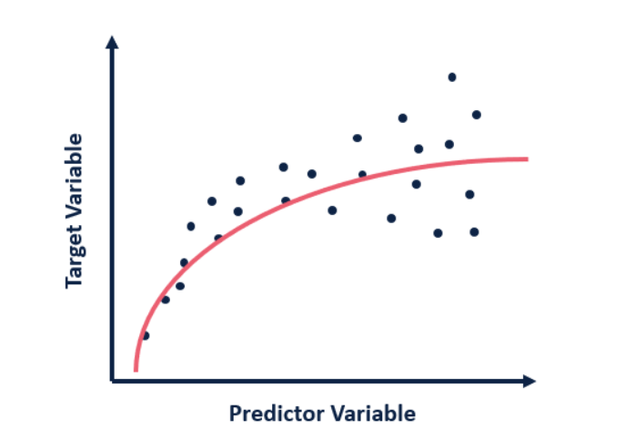
Underfitting
Overfitting

Slide 16
